Slide 1
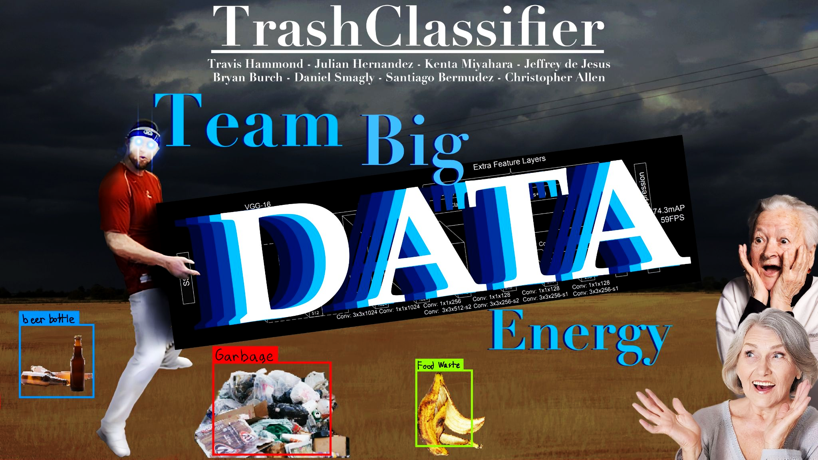


Slide 2
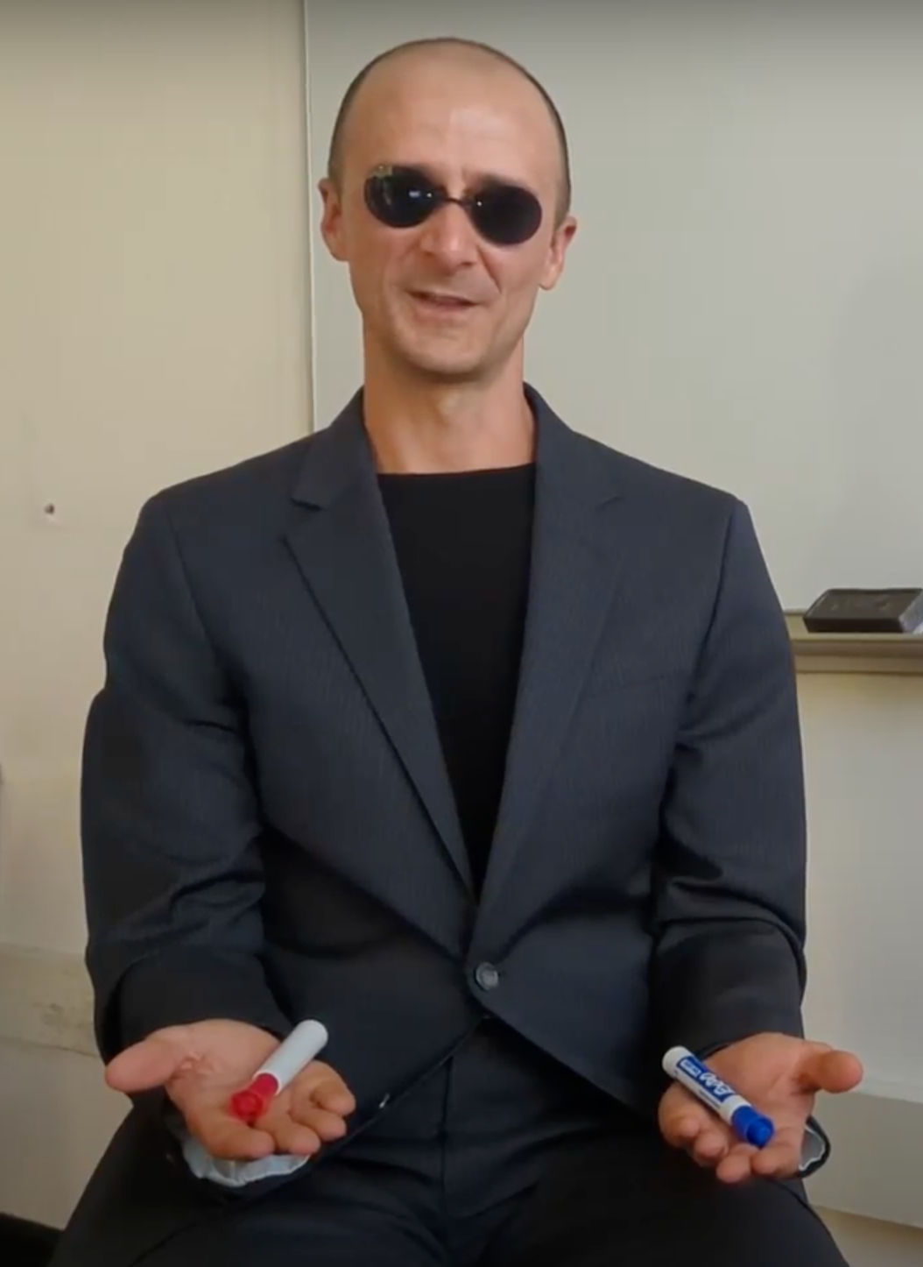
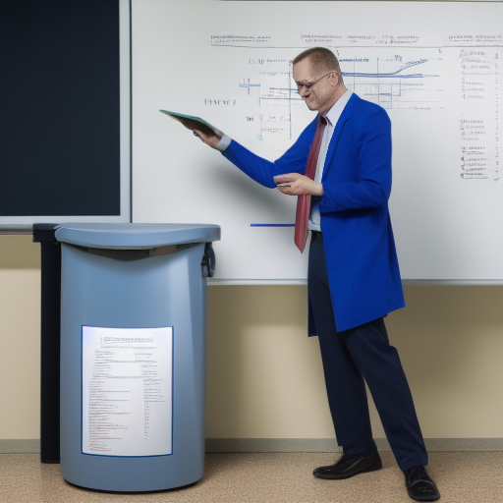
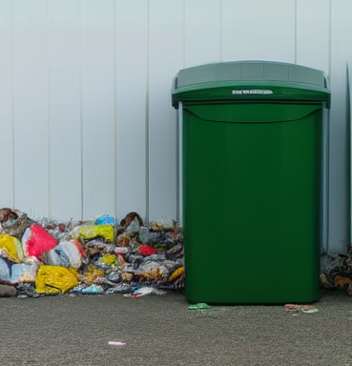
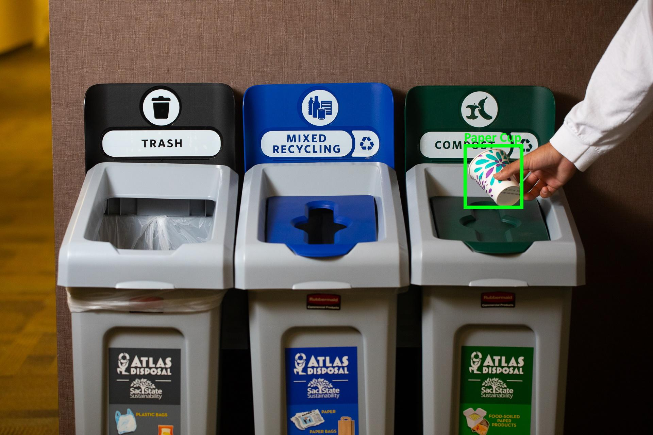
Project Overview
Current Presenter:
Travis Hammond
Dr. Clark Fitzgerald CSUS Professor in Math/Stats Department | Client’s Interest Research in statistics & machine learning as well as improving proper trash disposal | Client’s Problem Wants a tool to classify trash objects and decide the appropriate trash bin of such objects | Proposed Solution Application that locates and classifies trash in images with a deep neural network models
Notes:
Our Client
Dr. Fitzgerald, CSUS Professor in Math/Stats Department
Our Client’s business
Interested in research involving statistics and machine learning as well as improving proper trash disposing and trash pick up
Our Client’s problem
Wants a tool to classify trash objects and decide the trash bin such objects belong in
The proposed the solution:
Our team’s solution creates an application that can be used to find trash and classify trash in images with a deep neural network model

Slide 3
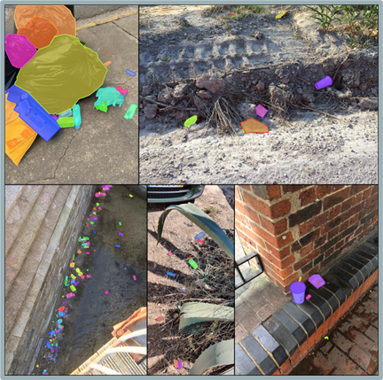
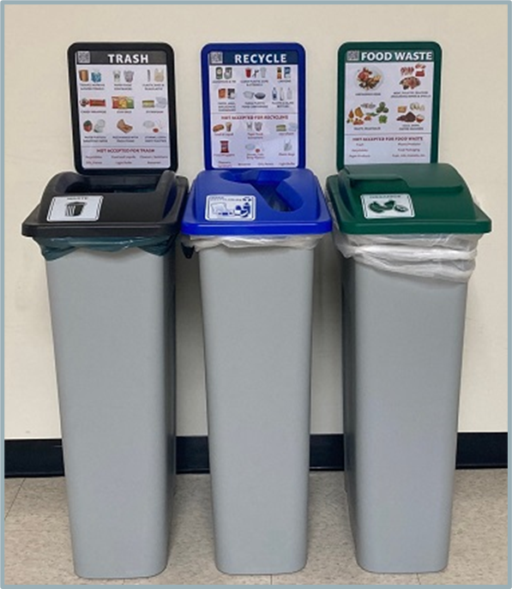
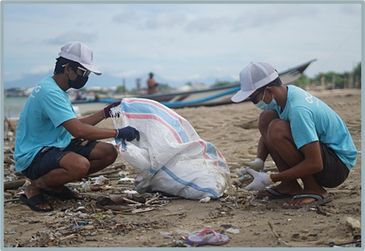
Solution
Current Presenter:
Julian Hernandez
Partner with the American River Parkway Foundation to collect training images | Train a robust computer vision algorithm that can detect many types of litter | Use City of Sacramento’s public API to find which trash bin to place the trash

Slide 4
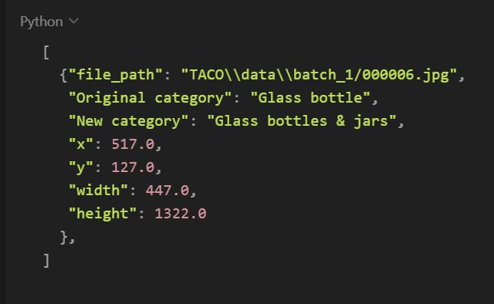
Software Requirements
Current Presenter:
Kenta Miyahara
UI Requirements
Menu
Classify
Live, captured image, file/folder
Annotate Trash
annotating after image capture
annotating images from file
Trash Description
Setting
About
Backend/Database Requirements
Return classification given a image from the front-end
Return optimized current model to the front-end
Run data annotation on the front-end
ERD / Database design
Machine Learning Requirements
Accuracy with 75% or higher
Gives bounding boxes
Bin classification (trash, recycle, compost, etc…)
Runs efficiently
Notes:
Opted for rest API for the backend. It is flexible and easy to implement. Our Rest API will communicate with SQlite and will return informations like classification results and models.

Slide 5
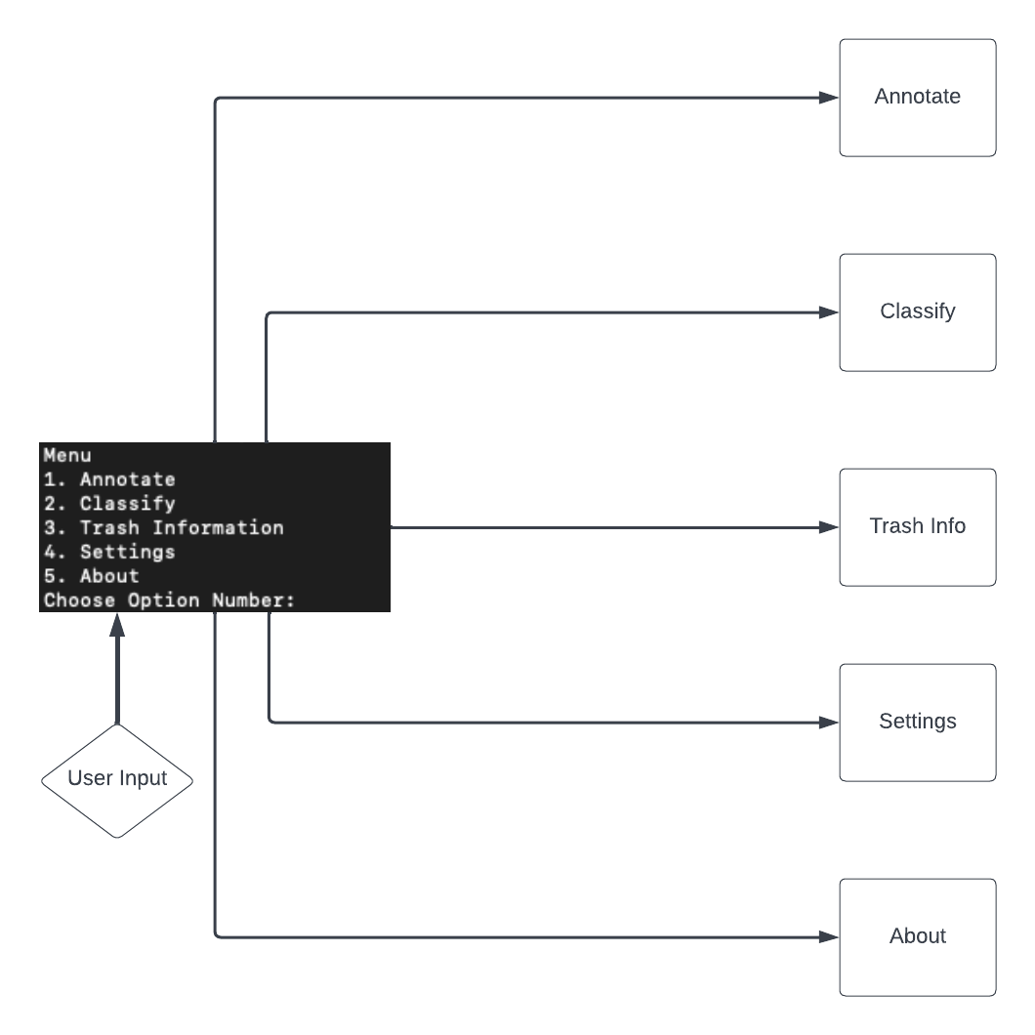
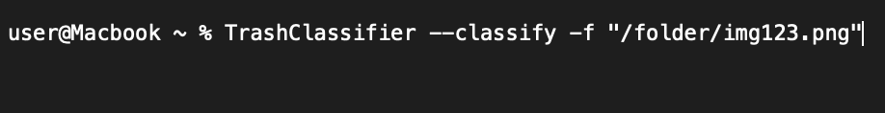
Demo – UI Prototypes
Current Presenter:
Jeffrey de Jesus
Interactive command line application
Functionality will be expanded to shell application which can be used in conjunction with other programs
No plans for building this into website
very simple to expand upon
something client will consider in future

Slide 6
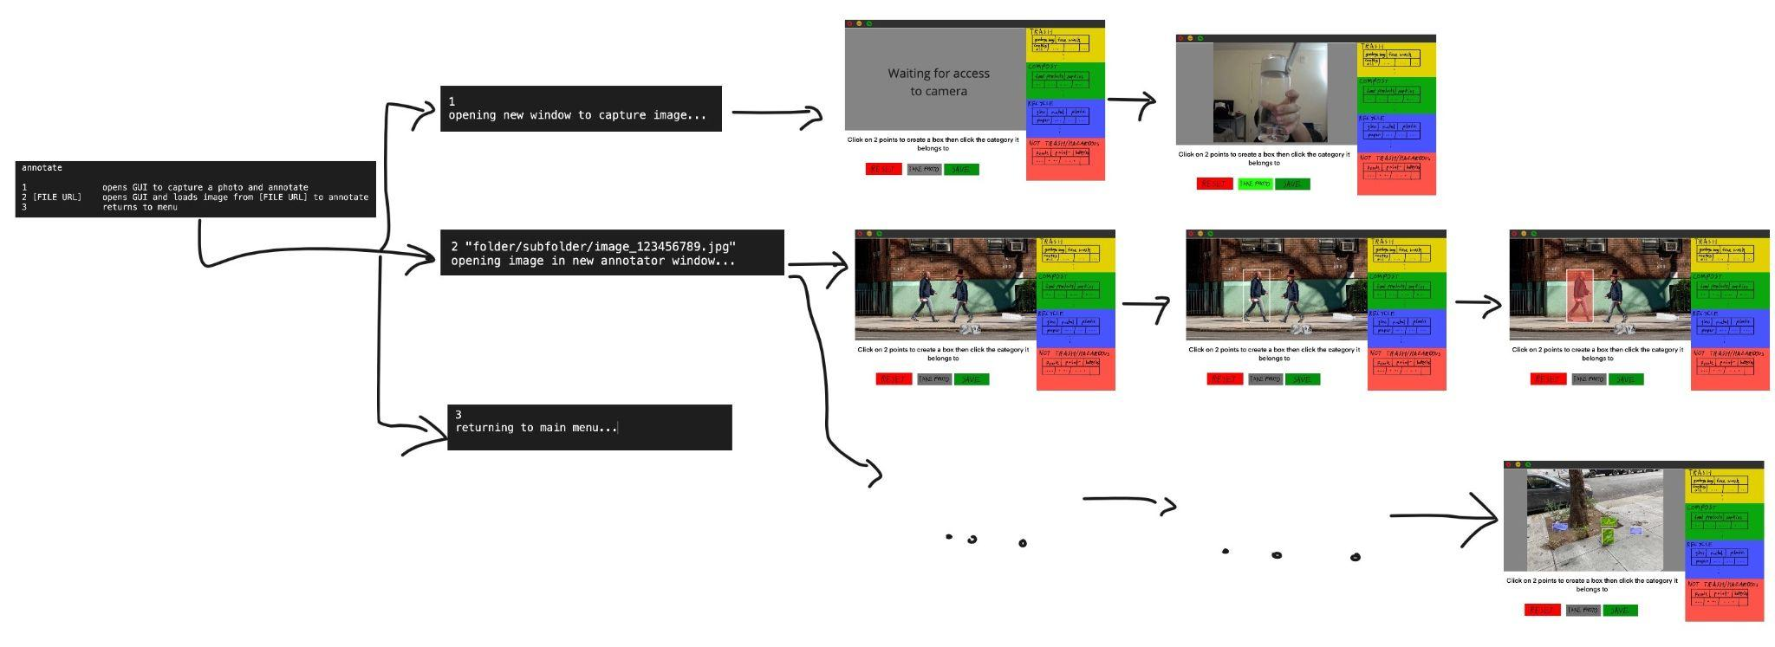
Current Presenter:
Jeffrey de Jesus

Slide 7
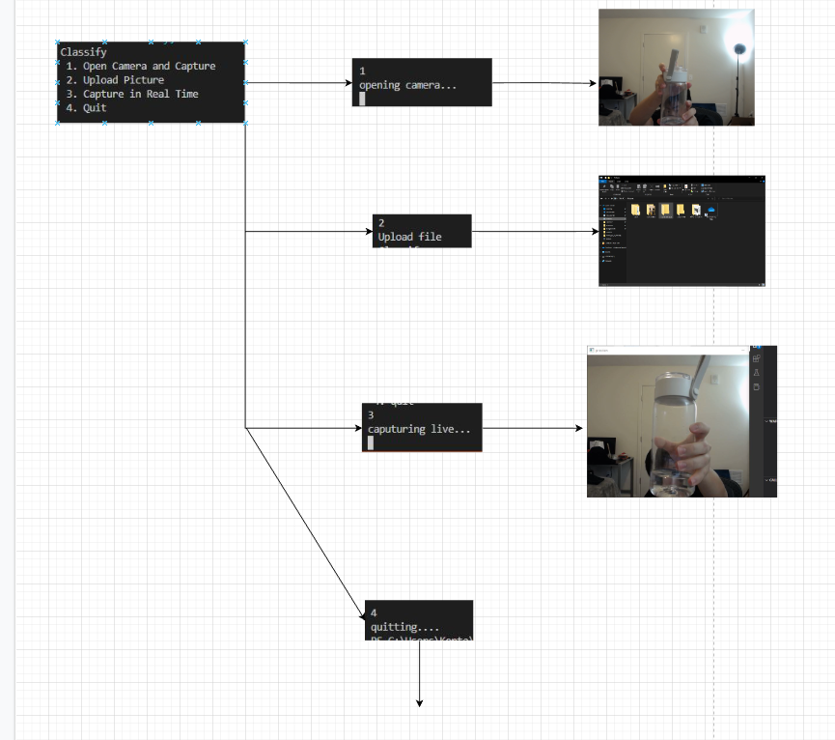
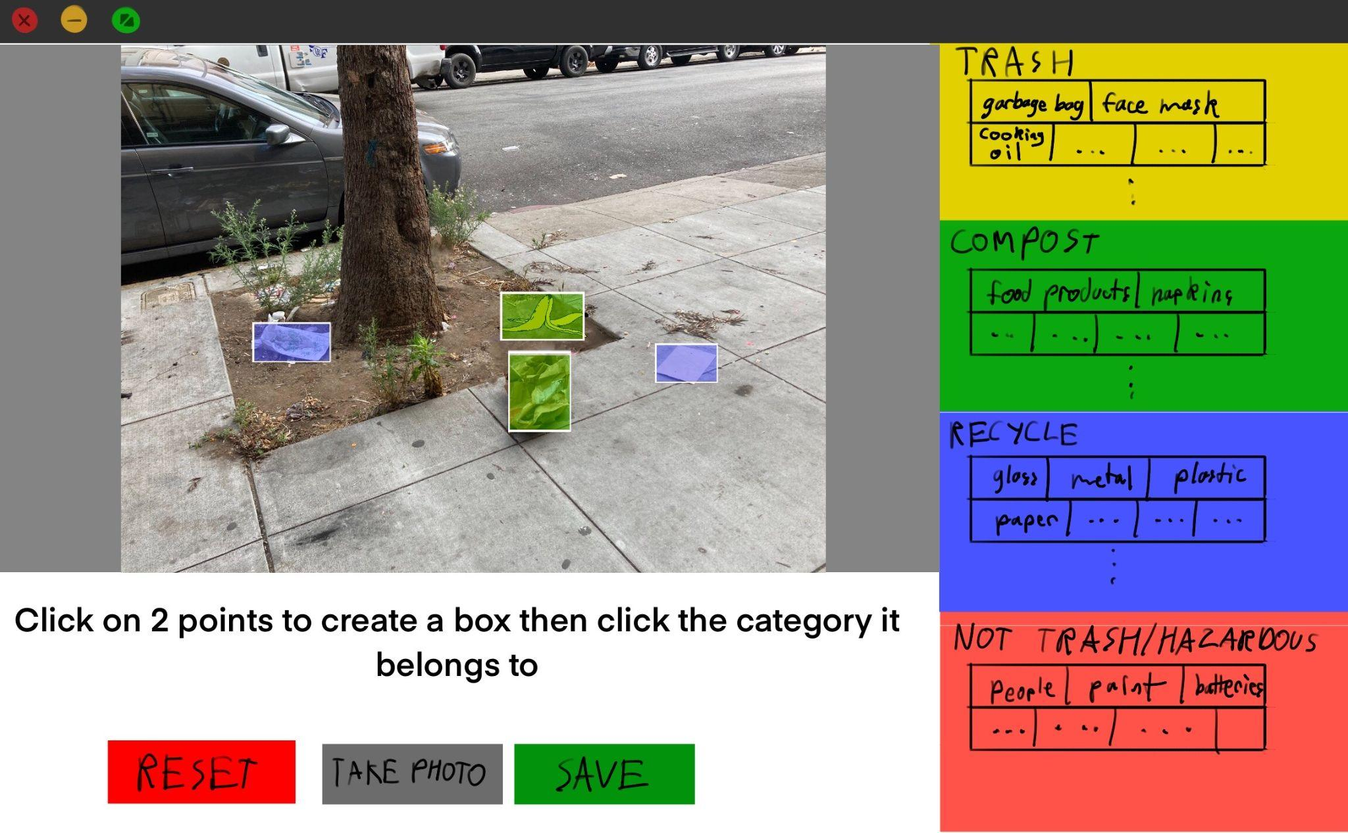
Current Presenter:
Jeffrey de Jesus

Slide 8
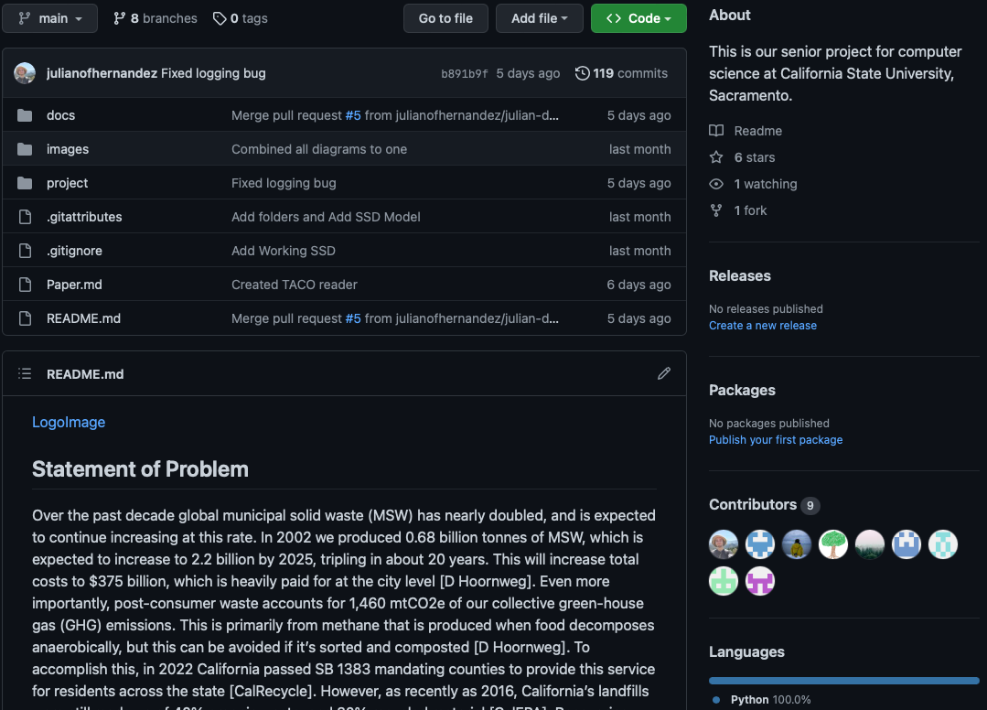
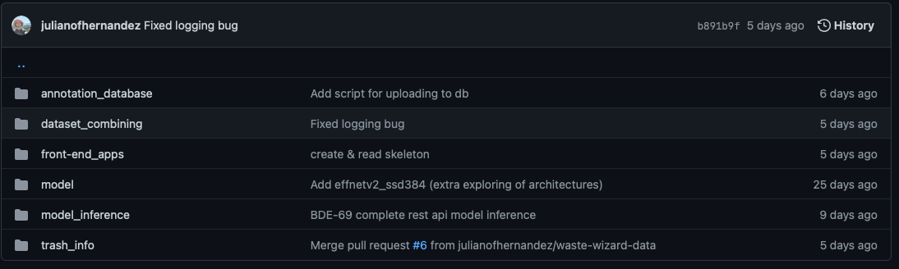
Demo – Functional Prototypes
Current Presenter:
Bryan Burch
Notes:
High level overview

Slide 9

Current Presenter:
Bryan Burch

Slide 10

Model Inference & Training Dataset REST API
Current Presenter:
Daniel Smagly
Model Inference API:
Model inference API designed to handle model features as well as retrieve new models.
Modular design keeps API design simple and custom tailored to project needs.
API written in Flask/Python to allows for common structure and simple portability to web-based front end if needed.
Training Dataset API:
Training dataset API is designed to handle image annotations, image tags as well as manage database contents.
This API design useful for the existing dataset design, and simple modular design allows for easy portability to other projects with similar functionality.

Slide 11
Sprint Summaries
Current Presenter:
Santiago Bermudez
Sprint 1 Research Drawing diagrams Picking tools Creating documents | Sprint 2 Drawing UI prototypes Formalizing acceptance criteria Make a list of objects to detect | Sprint 3 Implement skeleton REST API Start work on a base menu Start looking at model architecture | Sprint 4 Work on completing REST API Write scripts to work with dataset Work on menu options and annotations
Notes:
https://santiagobermudez.atlassian.net/jira/software/projects/BDE/boards/2/backlog
https://santiagobermudez.atlassian.net/jira/software/projects/BDE/boards/2/reports/burndown

Slide 12
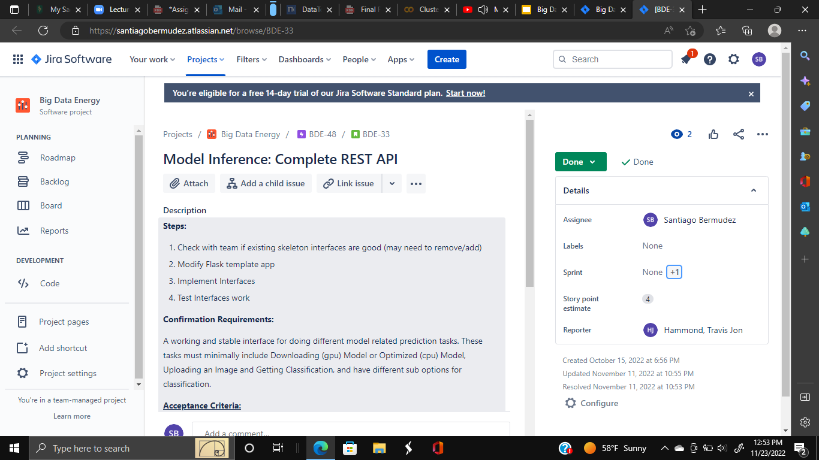
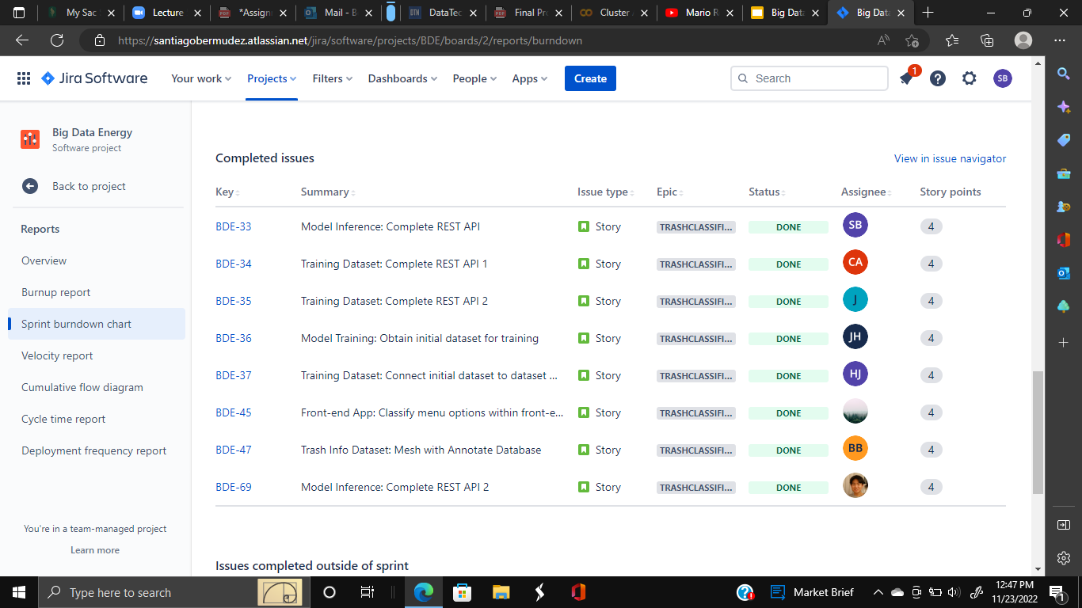
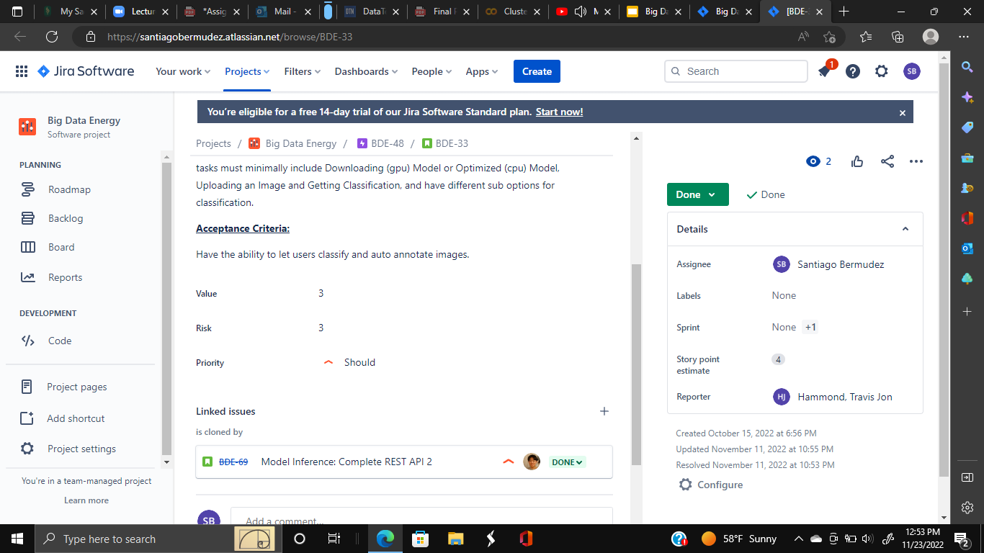
User Stories
Current Presenter:
Santiago Bermudez
Notes:
https://santiagobermudez.atlassian.net/jira/software/projects/BDE/boards/2/backlog
https://santiagobermudez.atlassian.net/jira/software/projects/BDE/boards/2/reports/burndown

Slide 13
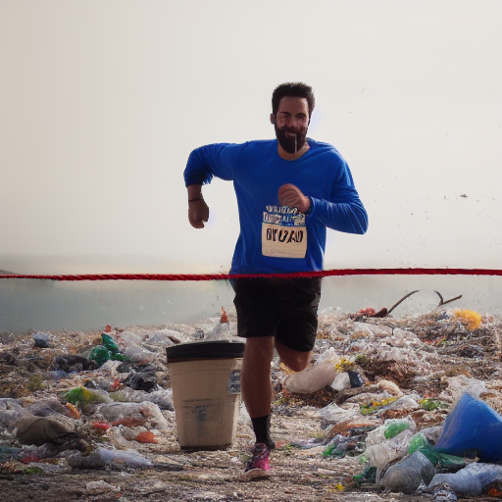
Conclusion
Current Presenter:
Christopher Allen
Client’s feedback
- Liked progress we have made so far - Wants a minimum viable product ASAP - Start unit testing in our next sprint for CSC 191
Insights - Communication is key - Working together through any blockers can really help keep things on track
Plans for CSC 191…
Model and Dataset Training
Finalize rest of product, and optimize
Start unit testing

Slide 14
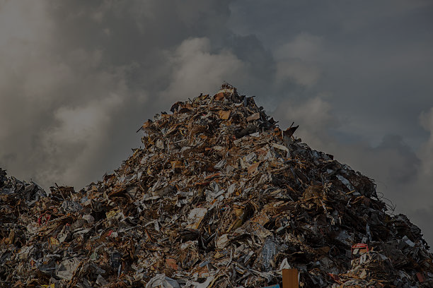


Q&A

